Slide 1
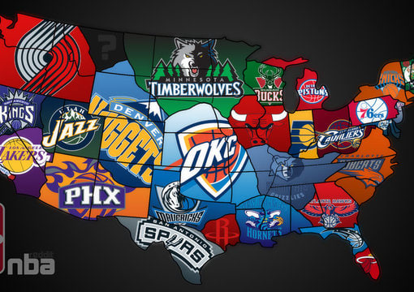
Average NBA Salary Analysis
By:
Anthony Orozco
10/10/2020

Slide 2
Background
The National Basketball Association has been growing at an exponential rate in terms of revenue over the past decade. A big reason for this is the tv deal signed with ESPN and Turner Sports in 2014 worth $24 billion/9 years. The new deal has led to max salaries increasing for top players every year since then. With a substantial financial change in the game, it has added to the pressure on players to perform and small market teams to compete with larger markets to retain talent.
The growing market of the NBA has led to analysts frequently debating over what determines if a certain star caliber player is worth the max salary and contract term of 5 years. To settle this, I will need to analyze for the best ways to make an accurate prediction of players average salary. Reasoning for this structure is due to the recent trend of owners/organizations to rely on collection of player data from what statistics analysts are recording.
Based on previous NBA literature, the most typical variables that are considered significant factors are points per game, free throw percentage, field goal percentage and most notably 3-point percentage. Also there are some requirements before a player can receive the max in order to qualify such as; 7 to 8 years of service, 2 years left on contract to receive 4 year contract, 1 year left on contact to receive 5 year max, or no years left on contact(free agent) to receive 5 year max. Also the player must meet one of the following three: be named to an All-NBA team in most reason season or prior two, be named NBA Defensive Player of the Year in most recent season or both seasons prior or be named NBA MVP in any of the previous 3 seasons.

Slide 3

Motivation
The NBA which is typically seen as one of the top sources of entertainment, has continued to grow in terms of size and monetary worth. My analysis will solve the how and why for what determines if players will achieve a supermax or top contract.
This will be done by pulling data from the top 100 players career stats based on points per game for the most recent NBA season (2019-2020). This will provide meaningful insight for the direction the NBA is heading from an analytical and financial outlook and what players should focus on with their respective games to achieve a top tier.

Slide 4
Main Questions
What is the mean, standard deviation of average player salaries and then the correlations between each variable and the response variable (average salary)?
Do the graphs and clusters of salaries by predictors provide meaningful insight?
What variables are the best predictors?
AGE + Seasons + GP + GS + MIN + PTS + FGM + FGA + `FG%` + `3PM` + `3PA` + `3P%` + FTM + FTA + `FT%` + OREB + DREB + REB + AST + STL + BLK + TOV + PF + `Contract term`
Best model?
Stepwise multiple linear regression(Interactions vs no interactions)
Support Vector Regression
Which model analysis is the most significant in predicting average salary?
Which model is the most accurate in predicting player salary?

Slide 5
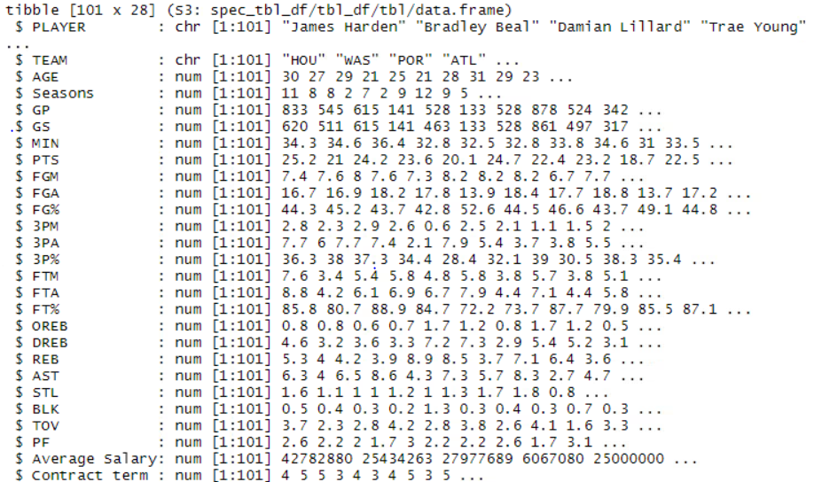
The Data

Slide 6
Analysis Techniques
Exploratory
Plots: correlation, mean, std, boxplots, scatterplots
Cluster Dendrogram
Inferential
Multiple Linear Regression
Support Vector Regression
Comparision of Linear Regression between tiers of players

Slide 7

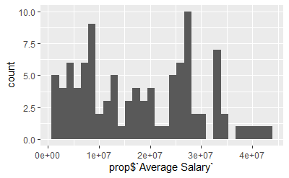
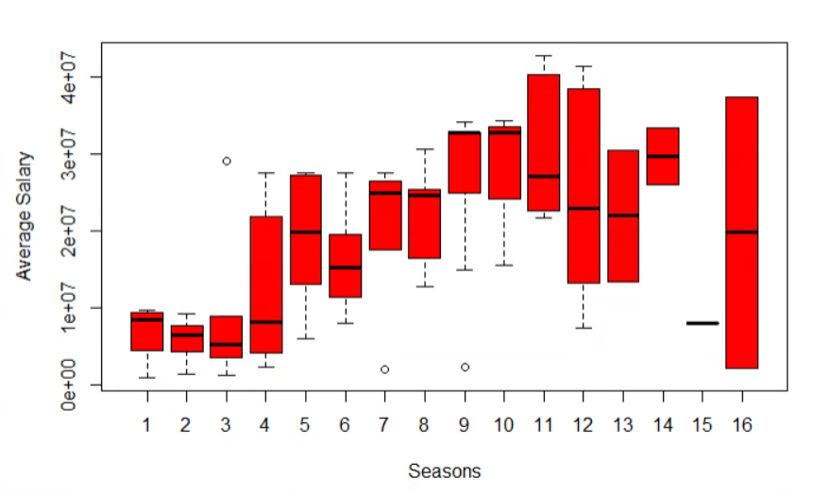
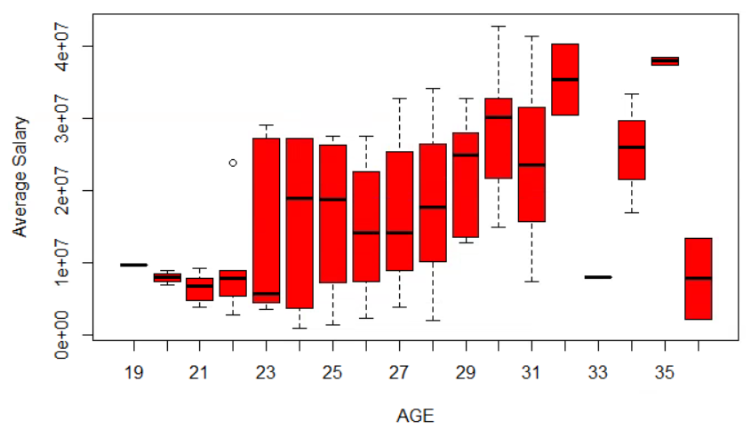
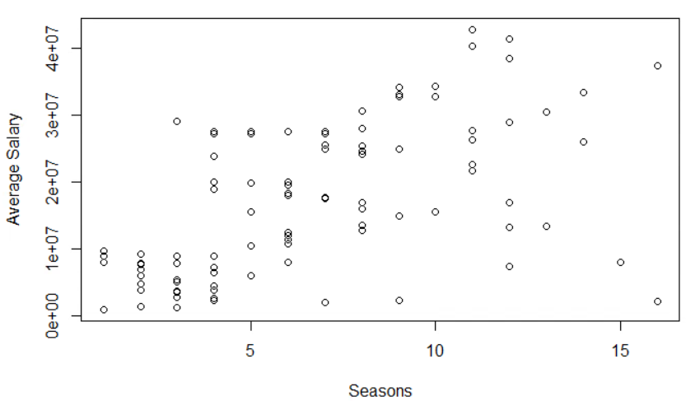
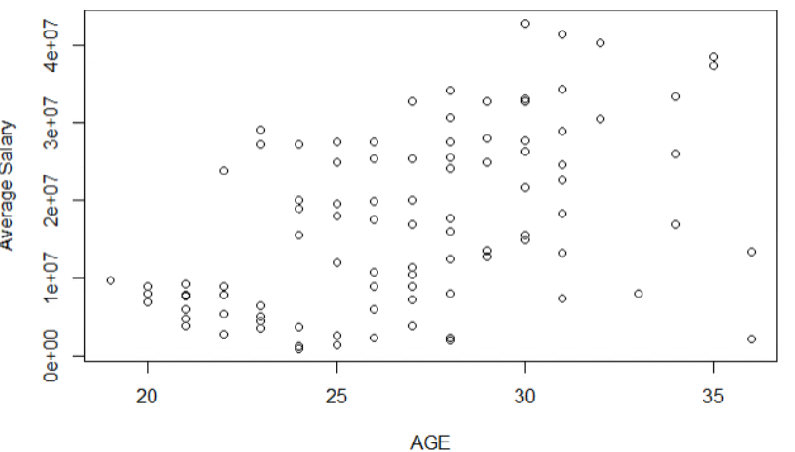
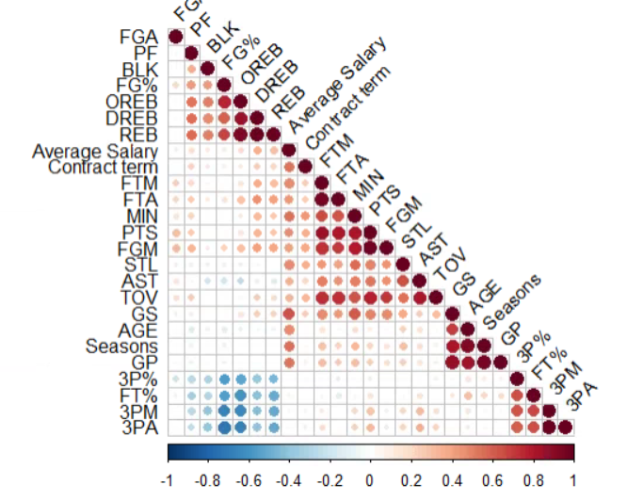
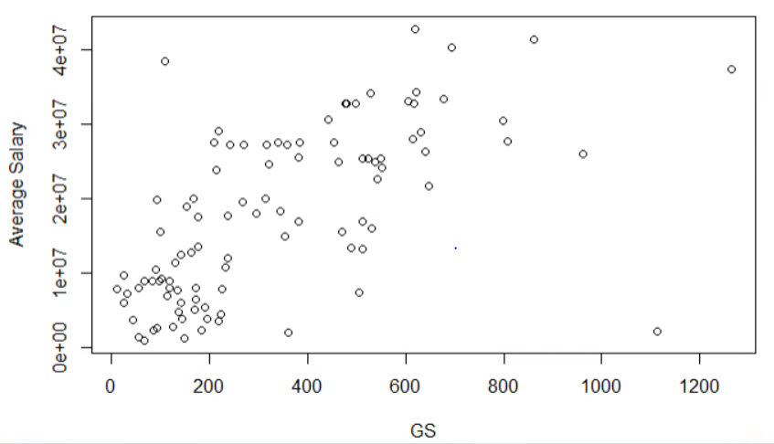
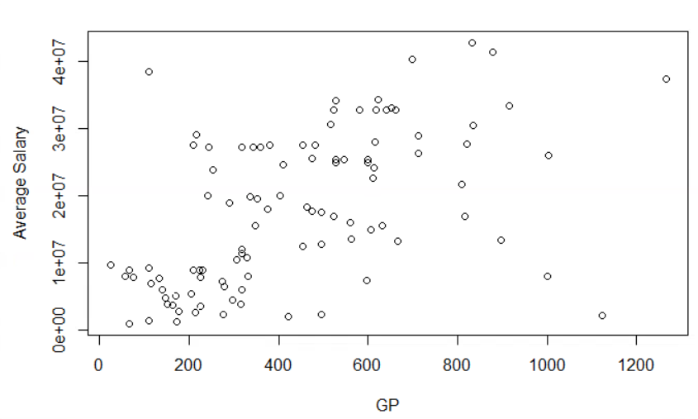
Exploratory Analysis
Note: The count of players salary requires clustering for a clearer visual.

Slide 8
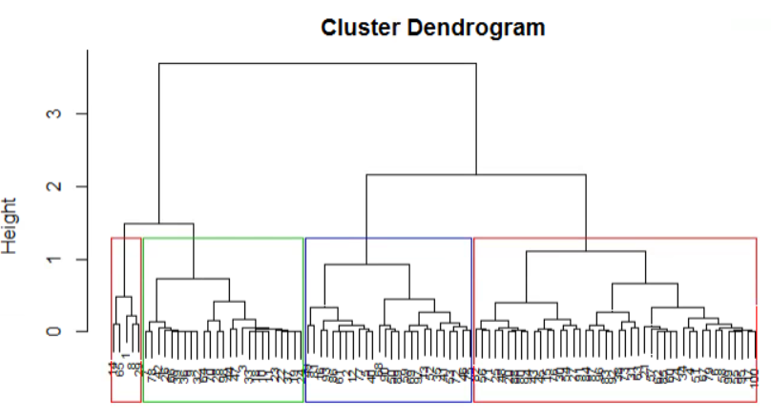
Exploratory Analysis-Dendrogram
There is a clear separation of tiers of players into 4 groups. Most notably 2 at a height of two and the best 5 players seen in the left bracket.
This will be studied further into my analysis of Average Salary when I separate the data into tiers.

Slide 9
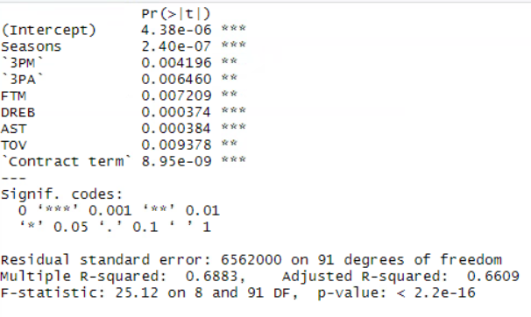
Multiple Regression (Stepwise-no interaction)
Utilizing stepwise regression, the model with the best AIC(3147.92 ) was:
best.model<- lm(`Average Salary` ~ Seasons + `3PM` + `3PA` + FTM + DREB + AST + TOV + `Contract term`, data = prop)

Slide 10
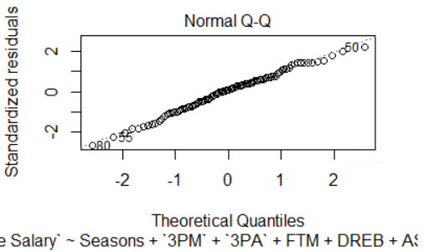
Significant Predictors, Summary, & Q-Q Plot
The data appears to follow the normality assumption based off the Q-Q plot visual

Slide 11
Multiple Regression Analysis(Stepwise-interaction)
Next, the interaction terms will be brought into consideration.
Typically one statistic for an NBA player is not enough to be a defining characteristic-
Best interaction model: best.interaction<- lm(`Average Salary` ~ AGE + Seasons + GP + GS + MIN + PTS + FGM + FGA + `FG%` + `3PM` + `3PA` + `3P%` + FTM + FTA + `FT%` + OREB + DREB + REB + AST + STL + BLK + TOV + PF + `Contract term` + Seasons:GP + Seasons:STL + STL:BLK + `FG%`:TOV + AGE:TOV + FTM:`Contract term` + PTS:`Contract term` + Seasons:`3PM` + AGE:`FG%` + TOV:`Contract term` + AGE:Seasons + AGE:BLK + `FG%`:`3PA` + `3PA`:PF + OREB:STL + GS:STL + FGA:`3P%` + GS:`FG%` + Seasons:BLK + AST:`Contract term` + AGE:GS + GP:BLK + FTM:BLK + Seasons:`FG%` + `3PA`:`3P%` + `3PM`:`3P%` + AGE:`3P%`, data =prop)
This interaction model was the closest I could achieve before overfitting of the variables.

Slide 12
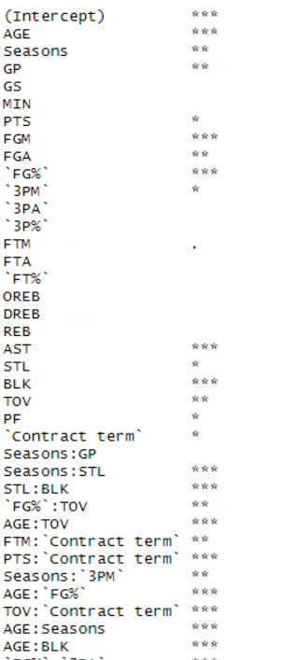
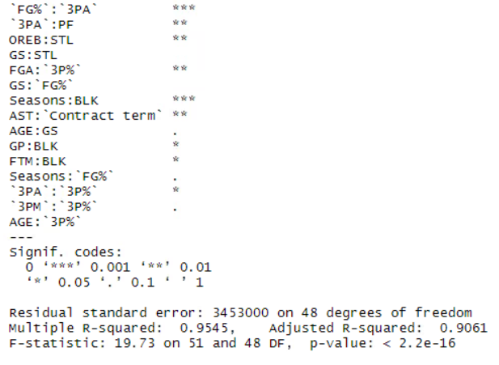
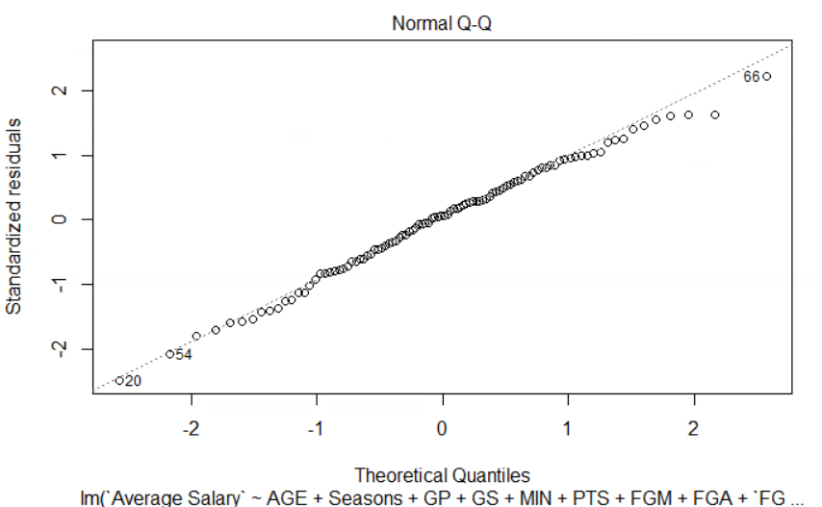
Significant Predictors, Summary, & Q-Q Plot
The 5 most significant predictors and first interactions in the model were: Seasons:Steals, Steals:Blocks, Age: Turnovers, Points:Contract Term, & Age:FG%.
The interaction model is following the assumption of normality.

Slide 13
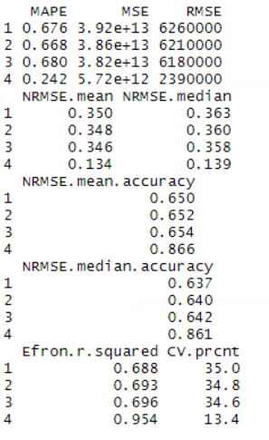
Multiple Regression Analysis (Prediction Accuracy)
The interaction model has the lowest RMSE and
is the most significant in predicting player salary out of all
Linear regression models.
Of the non interaction models, the third model:
third.model<- lm(`Average Salary` ~ Seasons + GS + `3PM` + `3PA` + FTM
+ DREB + AST + TOV + PF + `Contract term`, data =prop)
is the most accurate and predictive in explaining the
variability of average salary.

Slide 14
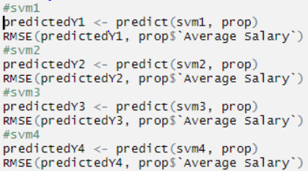

Support Vector Accuracy
I will now test the accuracy of the linear models in predicting average salary with Support Vector Models.
The interaction model as expected is the most accurate model, and more accurate than the interaction model built with linear regression.
The most accurate non-interaction model is the third model out of all linear and SVM models.
The models are more accurate by a ratio of 2:1 compared to the linear regression models.
Most predictive non-interaction model:
svm3 = svm(`Average Salary` ~ Seasons + GS + `3PM` + `3PA` + FTM + DREB +
AST + TOV + PF + `Contract term`, prop,kernal = 'radical', gamma = .1, cost = 10)

Slide 15
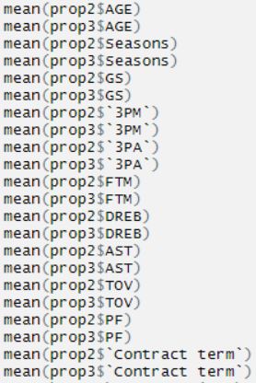
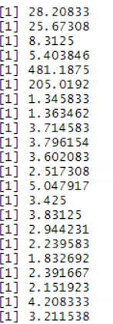
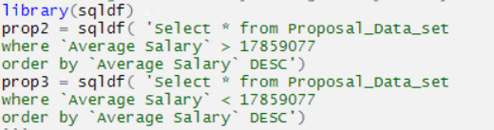
Separation of data by tiers
There is a clear separation in player salary of the top
100 NBA players.
The data was separated by all players above or
below mean salary.
The variables with the most separation are:
Age, Seasons, GS, FTM, DREB, AST, & Contract Term

Slide 16
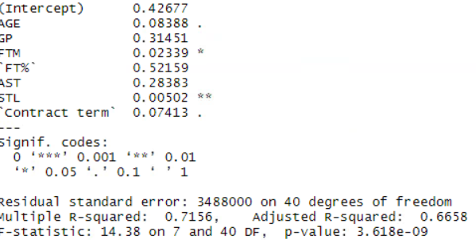
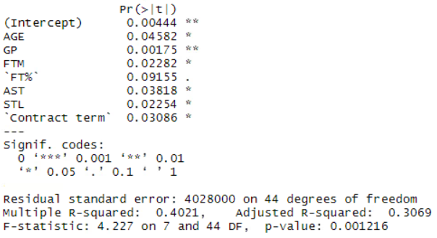
Difference is significance and accuracy
Now I compare the variables by way of stepwise regression to determine what variables are most significant in predicting which tier a player falls in.
Top tier model - best.tier = lm(`Average Salary` ~ AGE + GP + FTM + `FT%` + AST + STL + `Contract term`, data =prop2)
Lower tier model - lower.tier = lm(`Average Salary` ~ AGE + GP + FTM + `FT%` + AST + STL + `Contract term`, data = prop3)

Slide 17
Recap: Most Significant Predictors & Accurate Model
The combination of the variables that were the most predictive and accurate for non-interaction model in determining if a player receives a top deal are: Seasons + GS + `3PM` + `3PA` + FTM + DREB + AST + TOV + PF + `Contract term`
The variables that are the biggest indicators in difference of a player receiving a top tier deal or second tier deal are: AGE + GP + FTM + `FT%` + AST + STL + `Contract term`
The most accurate model with RMSE of 1106354 was svm3 = svm(`Average Salary` ~ Seasons + GS + `3PM` + `3PA` + FTM + DREB + AST + TOV + PF + `Contract term`, prop,kernal = 'radical', gamma = .1, cost = 10)

Slide 18
Recommendations
When evaluating which player should receive a top deal, Seasons, Games Started and Age clearly are the most important indicators of Average Salary.
This provides evidence that experience is by far the biggest factor in determining whether an individual player is worth being paid as a top contract.
The interaction of variables : Seasons:Steals, Steals:Blocks, Age: Turnovers, Points:Contract Term, & Age:FG% , show that consistency with steals over players early years, the combination of steals and blocks, the ability to limit turnovers as you age, the effect of Points with contract term, and Field Goal percentage by age, need to looked at when negotiating player salary.
3 pointers attempted and made also proved to be the most crucial predictors outside experience and proves that analytics in todays game are correct to pay players who can consistently make 3s.
Free Throws Made , Free Throw % , Assists, & Steals as stand-alone predictors are also critical when evaluating what salary to offer a player.

Slide 19
Sources
Stats.NBA.com
spotrac.com

